Slide 1
Autonomous Physics-Based Modeling of Retention Loss in 3-D NAND Flash Memory in Cryogenic condition EDL Manuscript Figure Change Myung Jin

Slide 2
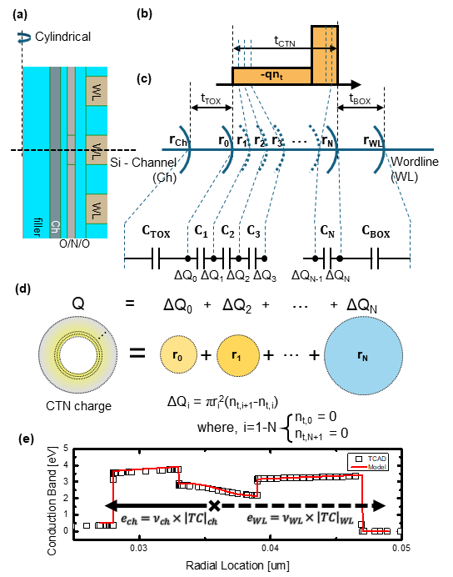
Detailed Poisson Solution
Fig. 1
Radial Slice
pgm charge
cylinder capacitance
charge component
Compatibility to TCAD

Slide 3
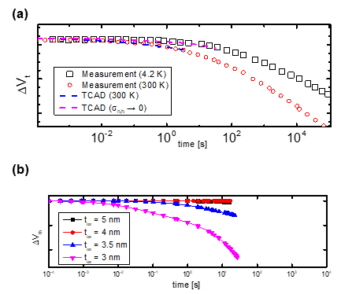
Autonomous Modeling & Result
Fig. 2
Cryogenic-like (σ → 0) simulation TCAD compatibility
model-TCAD match (on-going simulation!)
t_{ox} = 4.5 nm (on-going)
TCAD simulation & modeling matching for t_{ox} = 3 – 5 [nm] ongoing

